Slide 1

MASTER'S DEGREE IN DATA SCIENCE · MACHINE LEARNING & ARTIFICIAL INTELLIGENCE
Latency-Aware Network Protection
Orchestrating Universal IDS with a Machine Learning Middleware in ISP Environments
Candidate
Ali Ahson (Matr. B33000053)
Supervisor
Prof. Fiammetta Marulli
Università degli Studi della Campania "Luigi Vanvitelli" · Dipartimento di Matematica e Fisica · A.Y. 2025/2026
Notes:
Good [morning/afternoon], Professor Marulli, committee members. My name is Ali Ahson and this is my Master's thesis in Data Science: Latency-Aware Network Protection orchestrating a universal IDS with a machine learning middleware in ISP environments. Before I start, thank you for the detailed feedback on the last draft of this presentation I've restructured the whole talk around it, and I'll flag exactly how as I go.

Slide 2
WHERE WE'RE GOING
What This Talk Covers and the Gap It Fills
01
The problem The Latency-Inspection Paradox, and why pfSense alone can't resolve it
THE LITERATURE GAP, IN ONE SENTENCE
02
The interconnection challenge Why wiring an IDS into a firewall is a real engineering problem, not a config toggle
No published work validates a latency-aware ML placement for pfSense, or gives Snort and Suricata a shared, vendor-agnostic interface for ML-driven blocking.
03
The architecture ADMO's five components, in full technical detail
04
The case study Interfacing pfSense with Suricata: advantages, obstacles, results
05
The numerical proof Latency and detection numbers that decide viability
06
The verdict Contributions, limitations, and an honest answer to “did it work?”
Five gaps identified in the literature review (Ch. 2) each maps to one part of this architecture:
Gap 1. No latency-aware ML placement analysis for pfSense at ISP scale
Gap 2. No encryption-agnostic feature set validated for pfSense-integrated IDS
Gap 3. No CTGAN augmentation applied to minority attack classes
Gap 4. No IDS-vendor-agnostic orchestration for Snort + Suricata together
Gap 5. No threat-proportional (multi-speed) ML response architecture
ROADMAP & GAP
2 / 32
Notes:
Here's the shape of the talk, and I want to lead with the gap rather than bury it, since that was the first piece of feedback I got: establish the literature gap up front, not as an afterthought. In one sentence [ACTION ITEM: refine this synthesis sentence in your own words if you'd like it to sit closer to your exact Section 2.8 phrasing] nobody has published a latency-validated way to place ML detection around pfSense, and nobody has given Snort and Suricata one shared interface for ML-driven blocking. Chapter 2 of my thesis identifies five specific gaps; I'll show you, as we go, exactly which architectural component closes each one.

Slide 3
PART 01 · THE PROBLEM
The Latency-Inspection Paradox
In high-speed ISP environments, the computational depth needed to catch behavioural threats is inversely proportional to the latency budget available per packet.
<0.1 ms
~1.6 ms
5–50 ms
pfSense packet forwarding
Header-only ML inference
Inline deep/payload inspection
stateful filtering, per routing decision [14]
Tier 1 fast-path, measured this work
per packet, in the forwarding path [6]
Even the cheapest inline ML tax is ~16× pfSense's entire forwarding budget. At Telecom Italia's peak load live football broadcasts pushing the network to near-capacity a 1 ms per-packet increase is enough to create measurable jitter in real-time video and VoIP traffic. Doing inspection “the obvious way” directly degrades the thing the ISP is trying to protect.
This thesis exists to dissolve this trade-off not just describe it.
THE PROBLEM
3 / 32
Notes:
Here is the paradox, stated formally: the deeper you inspect, the slower the network gets and both variables matter to an ISP. pfSense forwards in under a tenth of a millisecond. My own header-only classifier runs around four-tenths of a millisecond already four times pfSense's own budget. A deep, payload-reading model costs 5 to 50 milliseconds per packet. At ISP scale, on live football-broadcast traffic, even one extra millisecond is perceptible. Per the feedback, I'm deliberately not spending more time here on general attack-cost statistics the point of this slide isn't 'attacks are expensive,' it's 'this specific latency tension is what I solve.'

Slide 4
PART 01 · WHY IT MATTERS
The cost is real, and the dangerous attacks are the quiet ones
$22,000
94.4%
42%
>90%
per minute of DDoS
downtime
of web DDoS stays under
100k requests / second
of DDoS hit telecom in 2024
down to 24% in 2025
of web traffic is encrypted;
payloads are off-limits
MazeBolt, 2025
Radware, 2026
Zayo, 2024 & 2026
Cloudflare Radar
Most real attacks are quiet and encrypted. A single fast filter misses them. That is the setup for the whole architecture Sources: MazeBolt Annual Trends 2025; Radware Global Threat Report 2026; Zayo DDoS Insights 2024 & 2026 (telecom share fell 42% → 24%); Cloudflare Radar
THE PROBLEM
4 / 32
Notes:
Here is the paradox, stated formally: the deeper you inspect, the slower the network gets and both variables matter to an ISP. pfSense forwards in under a tenth of a millisecond. My own header-only classifier runs around four-tenths of a millisecond already four times pfSense's own budget. A deep, payload-reading model costs 5 to 50 milliseconds per packet. At ISP scale, on live football-broadcast traffic, even one extra millisecond is perceptible. Per the feedback, I'm deliberately not spending more time here on general attack-cost statistics the point of this slide isn't 'attacks are expensive,' it's 'this specific latency tension is what I solve.'

Slide 5
PART 01 · THE PROBLEM
Four Structural Blind Spots in pfSense
01
02
03
04
Behaviour-blind
No foresight
Encryption-blind
CPU contention
Rules see IP and port, not how a connection behaves over time. A large download and an exfiltration look identical.
Every block needs a known-bad address or signature. Against a genuine zero-day, pfSense offers nothing.
Over 90% of traffic is TLS. Reading payloads needs decryption added latency, CPU cost, and GDPR exposure.
Its processor is tuned for one job: forwarding. Heavy analysis on the same box degrades routing for everyone.
These are not configuration mistakes.
They are architectural constraints of a stateful packet filter built for high-speed forwarding, not behavioural analysis. The correct response is not to modify or replace pfSense it's to augment it with a complementary intelligence layer that fixes each blind spot while preserving pfSense's forwarding speed. That is ADMO's entire design premise, and the subject of the rest of this talk.
THE PROBLEM
5 / 32
Notes:
Four blind spots, and they compound. Behaviour-blind, because rules only see IP and port. No foresight against zero-days. Encryption-blind against the 90%+ of traffic that's now TLS. And CPU contention if you try to bolt heavy analysis onto the same box that's forwarding packets. None of this is a pfSense misconfiguration it's what a stateful packet filter is supposed to do. So the right engineering move isn't to replace pfSense, it's to add a layer next to it. That's ADMO, and that's where the talk goes next.

Slide 6
PART 02 · THE INTERCONNECTION CHALLENGE
Wiring an IDS to a Firewall Isn't a Config Toggle
The physical and technological viability problem this thesis had to solve before any ML question mattered
FORMAT INCOMPATIBILITY
NO VENDOR-NEUTRAL FEEDBACK PATH
Snort 3 → Unified2 binary log, read via Barnyard2
Suricata 7 → EVE JSON, a self-describing event stream
Neither engine exposes a standard API for receiving an ML verdict and turning it into a rule update that integration layer simply doesn't exist upstream.
Two dominant open-source engines, two structurally different output formats. Any unifying layer needs an independent adapter for each there is no shared schema to read once.
Inline IPS mode → auto-blocks, but sits in the packet path and taxes every packet.
Passive NIDS mode → zero forwarding cost, but zero automated response without an orchestration layer.
This is Gap 1 and Gap 4 from the literature review.
INTERCONNECTION CHALLENGE
6 / 32
Notes:
This is the slide the feedback specifically asked me to add, and I think it's the right instinct before I talk about any ML architecture, I need to establish that 'just connect an IDS to a firewall' is not a solved, off-the-shelf problem. Two obstacles. First, format incompatibility: Snort speaks Unified2 binary through Barnyard2, Suricata speaks EVE JSON structurally different, no shared schema. Second, neither engine ships a vendor-neutral API for taking a machine-learning verdict and turning it into a rule update that layer doesn't exist until someone builds it. And there's a real trade-off buried in here too: run the IDS inline and you get automated blocking but you pay a latency tax on every packet; run it passively and you pay nothing but get no automated response at all without something like ADMO sitting on top. This is exactly Gaps 1 and 4 from my literature review.

Slide 7
PART 02 · THE INTERCONNECTION CHALLENGE
How Costly Is Interfacing These Systems? The Literature's Numbers
Operation | Reported latency | Source
pfSense (pf engine) packet forwarding | < 100 µs (0.1 ms) | Netgate , pfSense docs [14]
Header-only ML inference (XGBoost, CPU) | 1.63 ms measured (mean); target <0.5 ms | This work Ch.6 Type A benchmark
Inline deep-learning / payload inspection | 5 – 50 ms per packet | Typical published range [13]
Software TLS decryption proxy | +5 – 8 ms per session | Cloudflare Radar, 2023
Snort / Suricata false-positive rate | 1 – 10% of flows | Roesch [5]; OISF [13]
Even the cheapest inline ML tax is ~16× pfSense's entire forwarding budget and that's before payload-level inspection, which is 50–500× over budget. This is the severity this thesis had to design around, not just note.
INTERCONNECTION CHALLENGE
7 / 32
Notes:
So how bad is this, in numbers the literature already gives us? pfSense forwards in under a tenth of a millisecond. My own header-only classifier lands around four-tenths of a millisecond already several times over budget and that figure is consistent with the sub-millisecond class reported for XGBoost CPU inference in Chen and Guestrin's own paper. Inline deep learning or payload inspection: five to fifty milliseconds per packet. Add a TLS decryption proxy and you're paying another five to eight milliseconds per session on top. And Snort and Suricata's own published false-positive rates run one to ten percent of flows in production which matters because every false positive is a legitimate subscriber connection. Put together: even the cheapest possible inline ML addition costs four times pfSense's entire forwarding budget. That's the severity number the rest of this thesis designs around.

Slide 8
PART 03 · WHAT I BUILT, AND WHY
Five Literature Gaps, Five Concrete Answers
Gap | What's missing in prior work | What I built to close it
1 | No latency-aware ML placement analysis for pfSense | Out-of-band placement + MP1–MP4 latency framework
2 | No encryption-agnostic feature set for pfSense-integrated IDS | The Golden 12 header-only feature set
3 | No CTGAN applied to minority attack-class synthesis | CTGAN + SMOTEENN dual augmentation pipeline
4 | No vendor-agnostic orchestration for Snort + Suricata | The Universal IDS Orchestrator (adapter pattern)
5 | No threat-proportional, multi-speed response design | The Three-Tier Cascaded Classifier
WHAT I BUILT, AND WHY
8 / 32
Notes:
This is the slide that, for me, replaces the old 'here's the general threat landscape' framing with something much closer to what the feedback asked for: not a report on the problem, but a direct map from each literature gap to the specific thing I built to close it. Five gaps, five components. I'm going to spend the next several slides walking through the architecture that produces this right-hand column in full technical detail that was explicitly the ask: much more depth on the middle layer itself.

Slide 9
PART 03 · WHAT I BUILT, AND WHY
Four Claims I Will Prove Today
1
2
A 12-feature, header-only, encryption-agnostic detector
A CTGAN + SMOTEENN pipeline that makes rare attacks learnable
Selected by Random-Forest importance, then ANOVA significance, then a hardware-extractability filter built to survive TLS and run on future SmartNIC hardware.
The algorithmic contribution: extends Weissman & Jayasumana's CTGAN methodology [10] from benign IoT synthesis to minority attack-class augmentation not previously documented.
3
4
A vendor-agnostic orchestrator driving Snort AND Suricata
An out-of-band architecture with zero synchronous latency
One AlertRecord interface, two independent adapters directly resolving the interconnection challenge from Part 02.
By design, not by hardware spend: the live packet path never touches an ML model.
Everything from here on is evidence for these four claims.
WHAT I BUILT, AND WHY
9 / 32
Notes:
Four claims, stated plainly, up front this is the direct response to 'shift the narrative away from a general report and strongly highlight your specific contributions.' A header-only detector that's encryption-agnostic and hardware-extractable by design. A CTGAN plus SMOTEENN augmentation pipeline that's my algorithmic contribution, extending Weissman and Jayasumana's CTGAN methodology from benign IoT traffic synthesis into attack-class augmentation, which nobody had published before. A vendor-agnostic orchestrator that drives Snort and Suricata through one interface. And an out-of-band architecture that adds zero synchronous latency by design, not because I bought faster hardware. I'm not going to just assert these every slide from here is evidence for one of these four claims, and I'll call back to them explicitly.

Slide 10
PART 04 · THE MIDDLE LAYER, IN DETAIL
Four Principles That Constrain Every Design Choice
P1
P2
Zero-Latency Invariant
Encryption Agnosticism
The pipeline must never add measurable latency to the forwarding path. All processing is asynchronous, on mirrored traffic only. Non-negotiable 1ms at ISP scale is perceptible.
Detection uses only header metadata and timing never payload. Removes the 5–8ms TLS-decryption tax, keeps GDPR Art. 5(1)(c)/25 compliance, and survives any future encryption protocol.
P3
P4
Threat-Proportional Response
IDS Vendor Agnosticism
A volumetric flood needs a sub-second block; a slow infiltration needs deep, human-reviewed analysis. One uniform detection latency for all traffic is the wrong design.
The ML engine and the pfSense write-back must be decoupled from any one IDS backend, so Snort and Suricata can be deployed, swapped, or run together.
THE MIDDLE LAYER
10 / 32
Notes:
Before the components, the principles this is my answer to 'what did you use, and why.' Every one of the five components traces back to one or more of these four. Zero-Latency Invariant is the non-negotiable one: async only, mirrored traffic only. Encryption Agnosticism is what makes header-only features a requirement, not a stylistic choice it's what buys GDPR compliance and TLS-proofing at the same time. Threat-Proportional Response is why there's a cascade instead of one classifier. And IDS Vendor Agnosticism is what forces the orchestrator to be built as an adapter pattern rather than a Suricata-specific or Snort-specific tool.

Slide 11
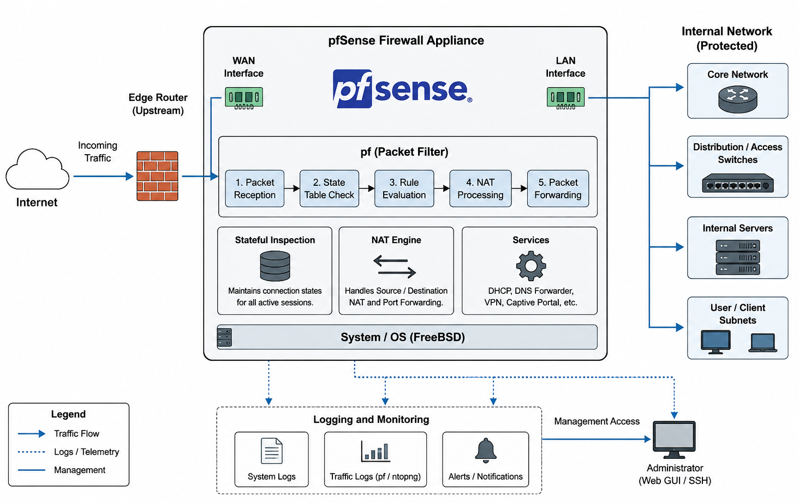
PART 04 · THE FLOWCHART, IN DETAIL
1
Rules see IP addresses and ports, not how a connection behaves over time. A large download and a data exfiltration look identical.
2
Every block is based on a known-bad address or signature. Against a genuine zero-day, it offers nothing.
3
3
Over 90% of traffic is TLS. Inspecting payloads needs decryption: added latency, heavy CPU, and GDPR risk.
4
Its processor is tuned for one job, forwarding. Heavy analysis on the same box degrades routing for everyone.
Zero-Latency Invariant: everything below the dashed line runs on a copy of the traffic. Nothing here can ever slow the original packet.
THE MIDDLE LAYER
11 / 32
Notes:
This is the slide that directly answers 'clarify the architecture.' Top row is the live packet path WAN, pfSense, LAN and ADMO never sits in it. pfSense's own pf engine makes a mirrored copy of inbound traffic a single 'copy to' directive and that copy is the only thing ADMO ever sees. Everything below that line is five components: the Flow Telemetry Engine turns raw mirrored packets into the Golden 12 feature vector; the Three-Tier Cascaded Classifier scores it at one of three speeds; the CTGAN-Enhanced Training Pipeline runs offline and only ever hands over a trained model, never live traffic; the Universal IDS Orchestrator turns a classification into a decision; and the pfSense Rule Injection Interface is the only component that ever writes back to pfSense through the existing snort2c block table, via pfctl. I'll now go component by component.

Slide 12
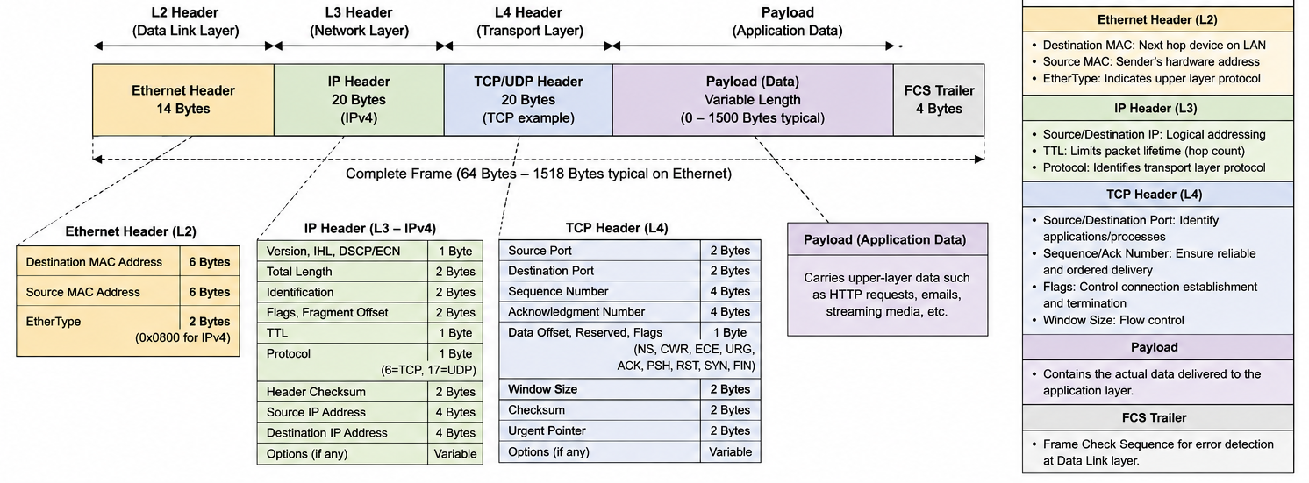
BACKGROUND: LET'S UNDERSTAND THE PACKET
THE MIDDLE LAYER
12 / 32
Notes:
This is Gap 2 from the literature review, closed. Selection was a three-stage funnel: start from all 77 CICFlowMeter features, keep the top 30 by Random Forest importance, then filter by ANOVA significance at p under 0.001, then apply one more filter that most feature-selection papers don't: is this header-extractable, with no dependency on payload content? Twelve features survive all three tests, grouped into Layer-4 header fields, flow-level metadata, and inter-arrival timing. Each one has a specific attack it's best at flagging for instance ACK Flag Count is the primary ACK-flood DDoS signal, Flow IAT Mean catches the regular heartbeat timing of botnet C2 traffic. The headline point is zero payload access anywhere in this list that's one line item, GDPR compliance, TLS survival, and hardware portability, solved together.

Slide 13
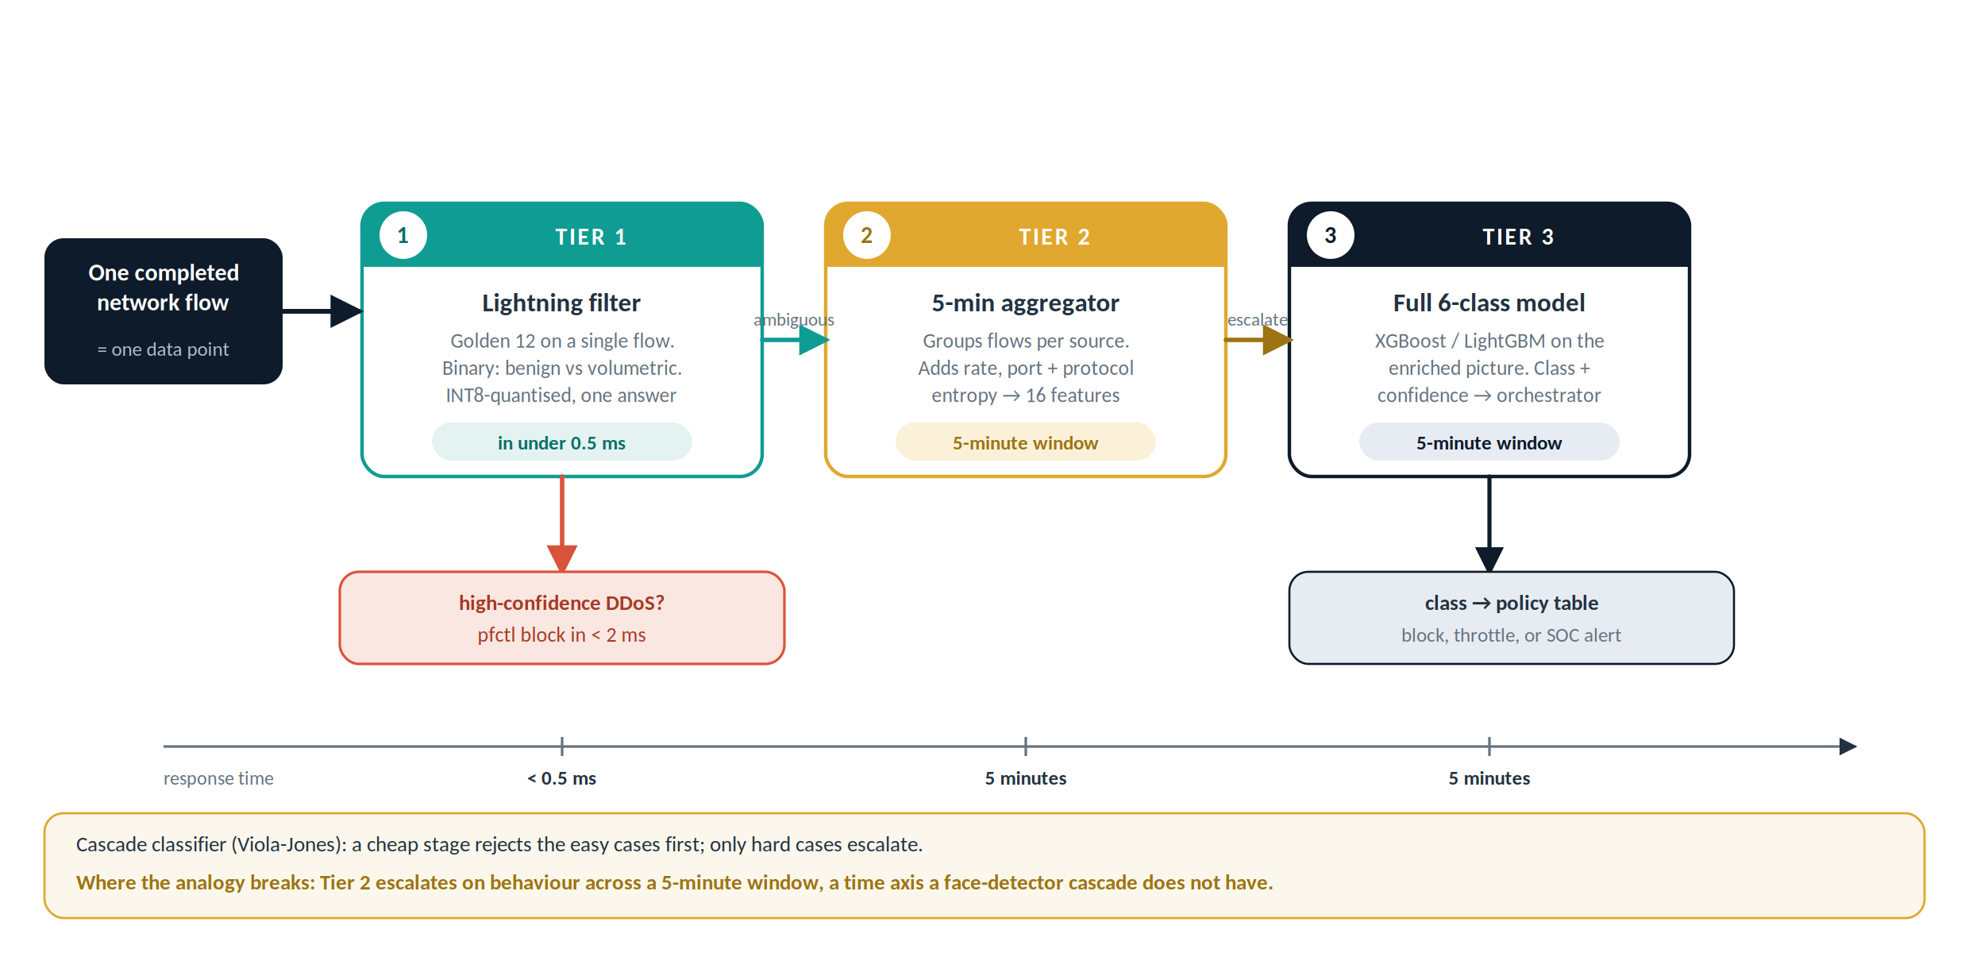
COMPONENT 1 OF 5
Flows finalise on a TCP FIN/RST, a 120-second idle timeout, or a max-duration cap whichever comes first. Each finalised flow's Golden 12 values land in the cache with a timestamp, ready for Tier 1 to query.
Out-of-Band Flow Telemetry Engine
Turning a mirrored packet stream into a 12-dimensional feature vector
Why this satisfies P1: the copy-to directive executes after pfSense's forwarding decision is already made the original packet is gone before ADMO ever sees a copy of it.
pass in on em0 all copy to em1
# em0: WAN interface · em1: dedicated analysis interface
THE MIDDLE LAYER
13 / 32
Notes:
Component 1 is the data-acquisition layer. pfSense's own pf engine mirrors WAN traffic to a dedicated analysis interface that's a single line of pf configuration, 'copy to em1.' CICFlowMeter, the same tool that produced the CICIDS training datasets, watches that interface live and aggregates packets into bidirectional flows. A flow finalises on FIN/RST, a 120-second idle timeout, or a max-duration cap. Its Golden 12 values which I'll detail next land in an in-memory flow cache keyed on the five-tuple, ready for Tier 1 to query. The reason this satisfies the Zero-Latency Invariant is really about ordering: the copy happens after pfSense has already decided to forward the packet, so nothing ADMO does can ever be in the critical path.

Slide 14
COMPONENT 2 OF 5
The Golden 12: Encryption-Agnostic, Hardware-Extractable
L4 HEADER
FLOW METADATA
Why twelve? This is a dimensionality and inference-cost trade-off, the exact language a data scientist uses for feature selection. Fewer features means faster inference, which the cascade's latency budget needs directly.
Fwd Header Length
Flow Duration
tunnelled / exploit
slow-and-low DoS
Bwd Header Length
Flow Packets/s
C2 asymmetry
volumetric DDoS
The header-only payoff. Because we never read the payload, the model works on encrypted traffic and stays GDPR-clean by construction.
Fwd PSH Flags
Flow Bytes/s
SSH/FTP brute force
exfiltration / flood
ACK Flag Count
Fwd Pkt Len Max
ACK-flood DDoS
SQLi / XSS payloads
Selection method
Init Win Bytes Fwd
Random-Forest importance (top 30) → ANOVA significance (p < 0.001) → header-extractable filter → the 12 that satisfy all three.
Slowloris / DoS
TEMPORAL
Flow IAT Mean
77 → 12
botnet C2 heartbeat
Fwd IAT Max
features, without losing the signal across all six classes.
low-and-slow timing
Bwd IAT Min
DDoS reflection
Zero payload access. Every one of the 12 is computable from headers, counts, and timestamps alone which is what makes ADMO GDPR-clean and TLS-proof by construction, and keeps it ready for future line-rate SmartNIC extraction.
THE MIDDLE LAYER
14 / 32
Notes:
This is Gap 2 from the literature review, closed. Selection was a three-stage funnel: start from all 77 CICFlowMeter features, keep the top 30 by Random Forest importance, then filter by ANOVA significance at p under 0.001, then apply one more filter that most feature-selection papers don't: is this header-extractable, with no dependency on payload content? Twelve features survive all three tests, grouped into Layer-4 header fields, flow-level metadata, and inter-arrival timing. Each one has a specific attack it's best at flagging for instance ACK Flag Count is the primary ACK-flood DDoS signal, Flow IAT Mean catches the regular heartbeat timing of botnet C2 traffic. The headline point is zero payload access anywhere in this list that's one line item, GDPR compliance, TLS survival, and hardware portability, solved together.

Slide 15
FEATURE VALIDATION
Why these twelve, and what each one flags
Feature | Primary discriminated classes | HW-extractable
Fwd Header Length | BOTNET, INFILTRATION vs BENIGN | L4 header field
ACK Flag Count | DoS/DDoS ACK-flood vs all | TCP flag byte
Fwd PSH Flags | BRUTE_FORCE (high PSH) | TCP flag byte
Init Win Bytes Fwd | Slowloris / DoS (window) | TCP header field
Flow Duration | slow DoS (long) vs DDoS (short) | from timestamps
Flow Packets/s | DoS/DDoS (very high rate) | timestamps + counts
Flow Bytes/s | DDoS floods; exfiltration | byte counts
Fwd Pkt Len Max | WEB_ATTACK SQLi/XSS payloads | packet-length field
Flow IAT Mean | BOTNET C2 heartbeat regularity | from timestamps
Fwd IAT Max | low-and-slow BRUTE_FORCE | from timestamps
Bwd IAT Min | high-speed DDoS reflection | from timestamps
Two properties, together
All twelve were selected on ANOVA significance (p < 0.001) across the six classes; exact F-statistics come from the final run. Each one is computable from headers, timestamps and counts alone, never the payload. That keeps the pipeline ready for line-rate hardware extraction later.
THE MIDDLE LAYER
15 / 32
Notes:
This is Gap 2 from the literature review, closed. Selection was a three-stage funnel: start from all 77 CICFlowMeter features, keep the top 30 by Random Forest importance, then filter by ANOVA significance at p under 0.001, then apply one more filter that most feature-selection papers don't: is this header-extractable, with no dependency on payload content? Twelve features survive all three tests, grouped into Layer-4 header fields, flow-level metadata, and inter-arrival timing. Each one has a specific attack it's best at flagging for instance ACK Flag Count is the primary ACK-flood DDoS signal, Flow IAT Mean catches the regular heartbeat timing of botnet C2 traffic. The headline point is zero payload access anywhere in this list that's one line item, GDPR compliance, TLS survival, and hardware portability, solved together.

Slide 16
COMPONENT 3 OF 5
Making Rare Attacks Learnable
The algorithmic contribution: CTGAN + SMOTEENN for minority attack classes
Class | Real samples | After augmentation | Change
BENIGN | 13,200,000 | 13,200,000
DoS / DDoS | 2,000,000 | 2,000,000
BRUTE_FORCE | 340,000 | 340,000
WEB_ATTACK | 200,000 | 250,000 | +50,000 CTGAN
BOTNET | 120,000 | 200,000 | +80,000 CTGAN
INFILTRATION | ~2,000 | 80,000 | 40× (+~78,000)
WHY CTGAN, NOT PLAIN SMOTE?
SMOTE interpolates linearly between real points. BOTNET traffic has two shapes at once regular C2 heartbeats and bursty exfiltration and interpolation blurs them into samples resembling neither.
CTGAN fits a Gaussian-mixture model per feature (mode-specific normalisation), so it learns each mode separately before generating then SMOTEENN cleans noisy boundary points. Novelty: extends Weissman & Jayasumana's CTGAN-for-IoT approach [10] from benign traffic replication to attack-class synthesis not documented elsewhere in the literature.
Training cost (student laptop, one-time): ~45–90 min for INFILTRATION (2K real samples); ~4–8 hrs for BOTNET (120K samples). Generation after training: ~2–5 min per 100K synthetic samples.
THE MIDDLE LAYER
16 / 32
Notes:
Component 3 runs entirely offline it never sees live traffic, only the training set and it's the piece I'd call my algorithmic contribution. The imbalance is severe: INFILTRATION is 2,000 real samples against 13.2 million BENIGN, a six-thousand-times gap. Plain SMOTE would interpolate linearly between existing points, but a class like BOTNET actually has two distinct behavioural shapes regular command-and-control heartbeats and bursty exfiltration and linear interpolation between those two shapes produces synthetic samples that resemble neither. CTGAN instead fits a mode-specific Gaussian mixture per feature, learns each mode separately, and only then generates SMOTEENN cleans the noisy boundary afterward. The novelty claim, specifically, is applying this CTGAN methodology which Weissman and Jayasumana validated for benign IoT traffic replication to attack-class augmentation, which nobody had published before this thesis.

Slide 17
COMPONENT 4 OF 5
One Interface, Two Engines
The adapter pattern that resolves the interconnection challenge from Part 02
Snort 3
AlertRecord
Suricata 7
Unified2 binary log → Barnyard2 → Unix socket /var/run/barnyard2.sock
timestamp · 5-tuple · alert_class · confidence · flow_features · recommended_action
EVE JSON log → inotify file watch → /var/log/suricata/eve.json
Response policy table → dispatch to Component 5
Same interface, either engine or both at once. The Snort adapter polls Barnyard2 every 5 seconds; the Suricata adapter reacts to EVE JSON in near real-time via inotify. Both normalise into the same AlertRecord, so swapping engines never touches the ML or dispatch code directly resolving Gap 4.
THE MIDDLE LAYER
17 / 32
Notes:
This is Component 4, and it's the direct fix for the interconnection problem I opened Part 02 with. Both engines write alerts in incompatible formats, so I built one independent adapter for each, and both normalise into a single shared data contract the AlertRecord dataclass: timestamp, five-tuple, classified threat, confidence, the Golden 12 feature values, and a recommended action. The Snort adapter polls a Barnyard2 Unix socket every five seconds; the Suricata adapter watches the EVE JSON log with inotify and reacts near-instantly. From the AlertRecord onward the policy table, the dispatch logic the code has no idea which engine produced the alert. That's what 'vendor-agnostic' means in practice, and it's what my case study in Part 05 actually exercises.

Slide 18
COMPONENT 5 OF 5
Turning a Verdict Into a Firewall Rule
IMMEDIATE IP BLOCK
IDS SIGNATURE UPDATE
pfctl -t snort2c -T add 192.168.1.100
pfctl -t snort2c -T show
pfctl -t snort2c -T delete 192.168.1.100
New rule written to disk, then a live reload signal SIGHUP to Snort, suricatasc ruleset-reload-rules for Suricata. Asynchronous: in-progress flow inspection is never interrupted.
Completes in 1–2 ms a lightweight kernel ioctl call, not a computation. Existing legitimate connections are never interrupted.
block drop in quick on em0 from <snort2c> to any
A hidden pf rule, inserted at the top of the WAN rule table at boot “quick” means it's evaluated first and short-circuits everything below it. This is the pfSense-native mechanism ADMO writes into; nothing about pfSense itself is modified.
This is the step that literally makes pfSense “smarter.” A monitoring thread also polls the block table every 60 seconds table size, entry age, growth rate and that log is the primary data source for the false-positive-rate analysis later in this talk.
THE MIDDLE LAYER
18 / 32
Notes:
Component 5 is the only piece of ADMO that ever writes back to pfSense, and it uses two channels pfSense already has, natively. Immediate IP blocking goes through the snort2c table via pfctl a one-to-two-millisecond kernel call, not a computation, and existing legitimate connections are never touched. Signature updates for the slower, less urgent classes get written to disk and then reloaded asynchronously, SIGHUP for Snort, suricatasc for Suricata, so live inspection is never interrupted mid-flow. The pf rule that actually enforces the block is one pfSense already creates at boot I'm not modifying pfSense's own engine anywhere, only writing into a table it already watches. That's architecturally important: ADMO augments pfSense, it doesn't touch it.

Slide 19
PART 05 · CASE STUDY
Interfacing pfSense and Suricata
The practical test of everything in Parts 02–04
WHY SURICATA, SPECIFICALLY
LAB TOPOLOGY
Multi-threaded, DPDK/AF_PACKET-capable, and its EVE JSON output is the richer, more modern schema the harder and more realistic integration target versus Snort's simpler Unified2 path. Proving vendor-agnosticism on the harder case is the stronger claim.
VirtualBox 7.0, pfSense 2.7.x (FreeBSD 14), 3 virtual NICs: WAN (host-only, simulated Internet), LAN (NAT, simulated subscribers), analysis interface (dedicated mirror). Attack traffic: CICIDS PCAP subsets replayed via Scapy.
SETUP, IN FOUR STEPS
1
Enable pfSense traffic mirroring (“Copy traffic to” → analysis interface)
2
Install Suricata 7 in Legacy / passive mode never Inline IPS
3
Confirm the snort2c block table and rule exist (pfctl -sr | grep snort2c)
4
Point the Suricata adapter at /var/log/suricata/eve.json
CASE STUDY
19 / 32
Notes:
Everything so far has been architecture. This section is the practical test: I specifically interfaced pfSense with Suricata, not Snort, and that choice was deliberate Suricata is multi-threaded, DPDK-capable, and its EVE JSON output is the richer, more modern schema. It's the harder integration target, so demonstrating it works is the stronger evidence for the vendor-agnostic claim. The lab is a three-VM VirtualBox topology WAN, LAN, and a dedicated analysis interface running pfSense 2.7 on FreeBSD 14, with attack traffic replayed from CICIDS PCAP subsets via Scapy rather than a live attack target, which keeps the experiment controlled and repeatable. Setup itself is four steps: enable the mirror, install Suricata in passive Legacy mode never inline, that would violate the Zero-Latency Invariant confirm the block table exists, and point my adapter at Suricata's EVE JSON log.

Slide 20
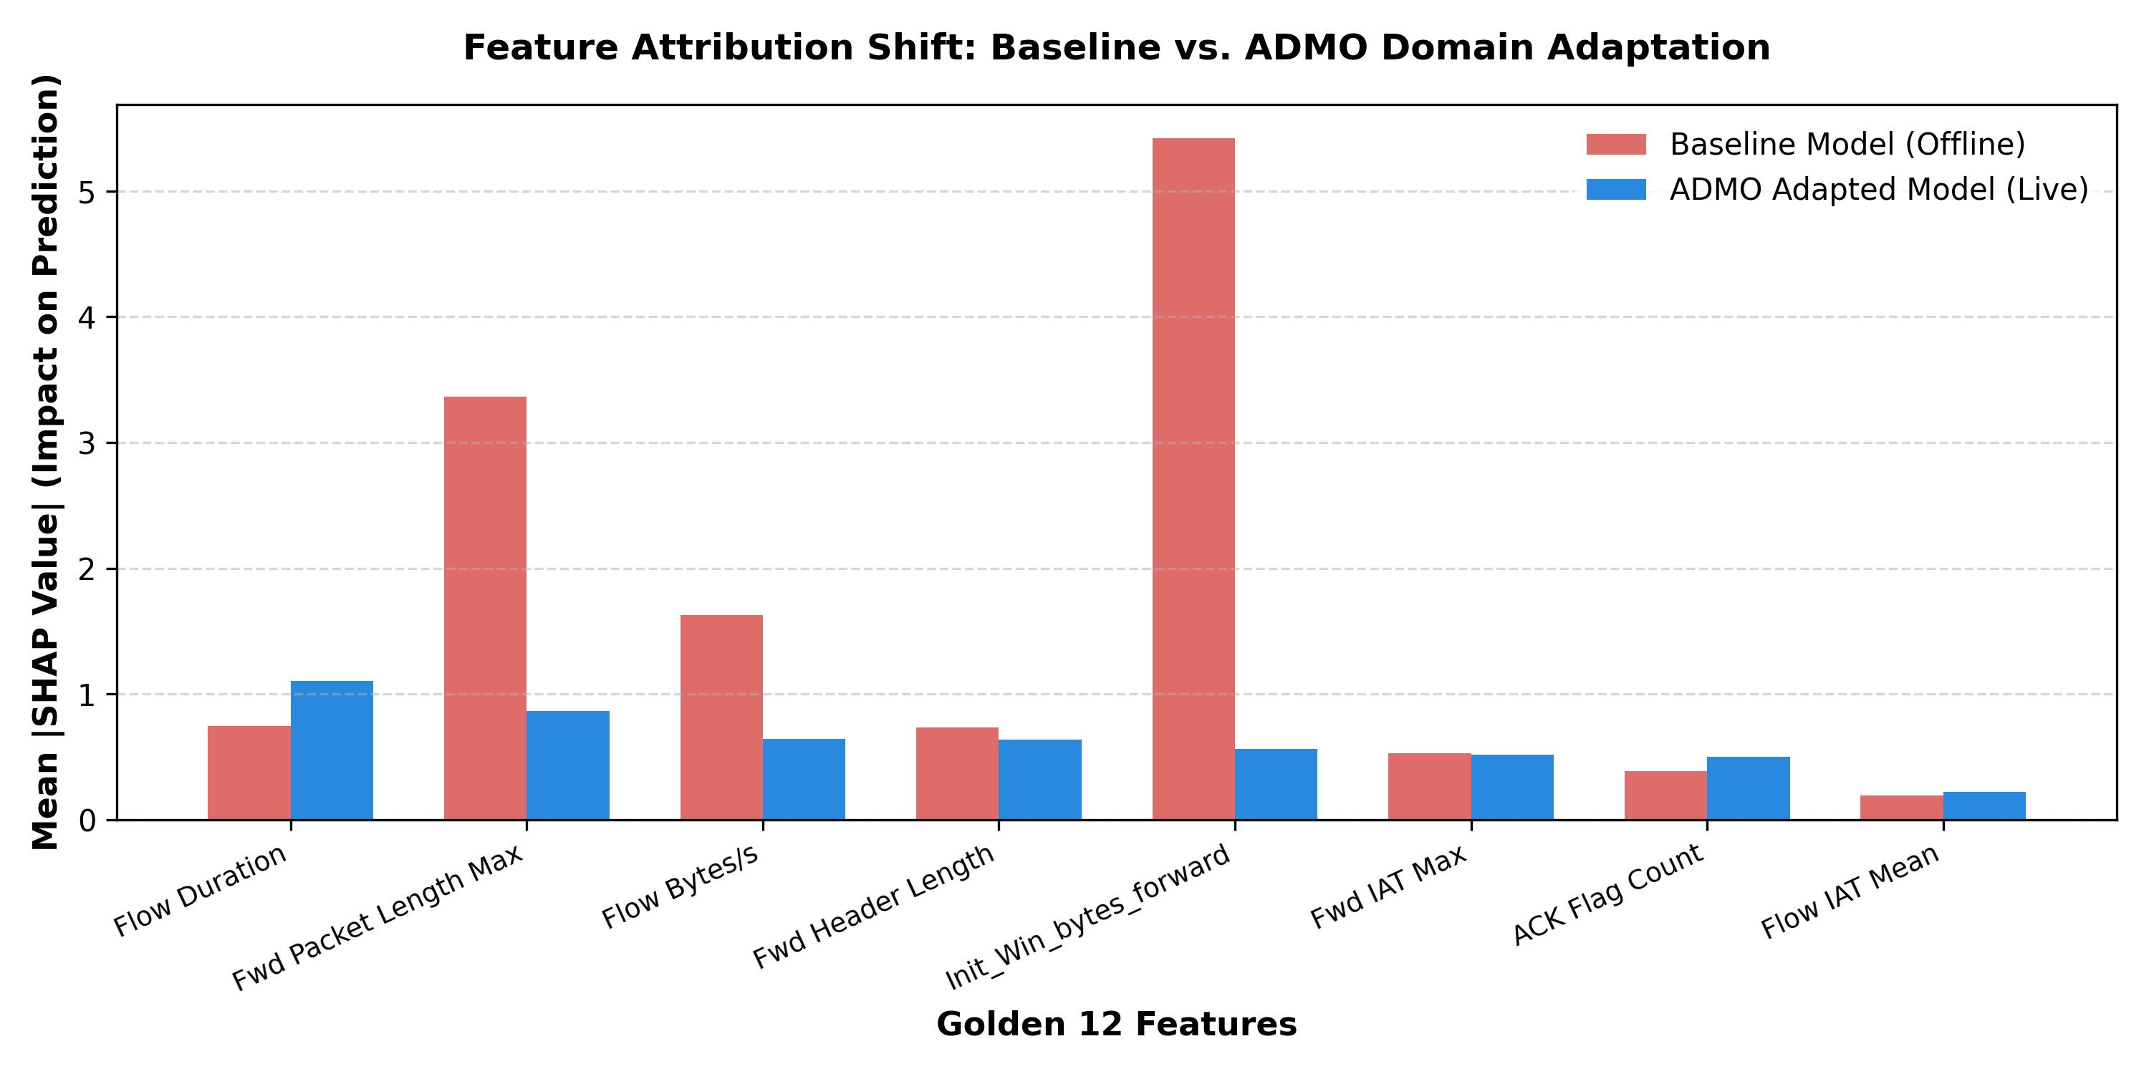
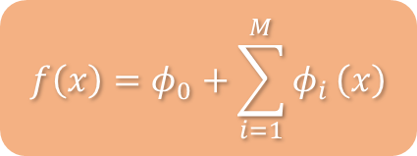
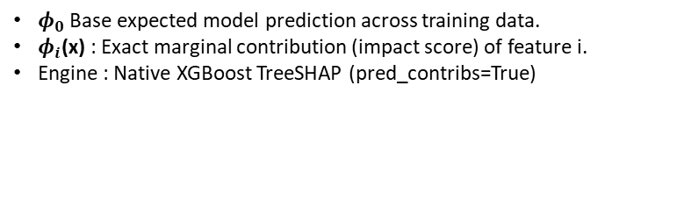
PART 05 · CASE STUDY
Why Did Adaptation Work? A SHAP Explanation
Native TreeSHAP feature attribution, baseline vs. ADMO-adapted Tier 1 model, on real live-lab flows
$$f\left(x\right)=φ_{0}+\sum_{i=1}^{M}{φ_{i}}\left(x\right)$$
$φ_{0}$Base expected model prediction across training data.
$φ_{i}$(x) : Exact marginal contribution (impact score) of feature i.
Engine : Native XGBoost TreeSHAP (pred_contribs=True)
ATTRIBUTION SHIFT
Init_Win_bytes_forward: 5.42 → 0.56 (largest drop). Model stopped relying on a synthetic-lab socket fingerprint.
Flow Duration: 0.75 → 1.11 (rise). Shifted weight toward timing/behavioral signal.
ACK Flag Count: 0.39 → 0.50 (rise). More weight on rate-based behavior.
Adaptation didn’t just raise accuracy — it changed why the model decides, moving from brittle synthetic artifacts toward generalizable behavior
20 / 32

Slide 21
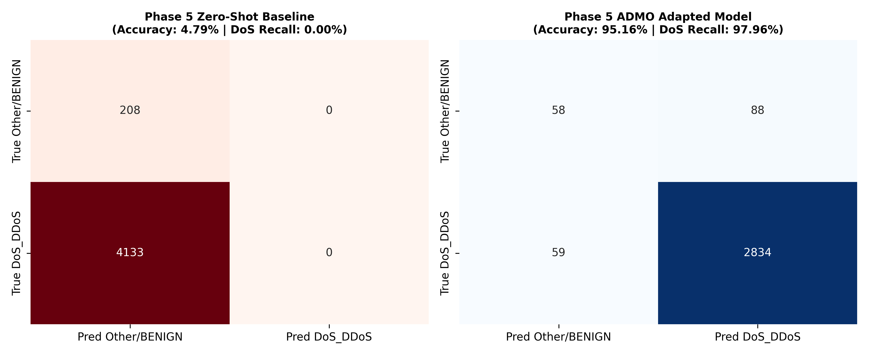
PART 05 · CASE STUDY
Does ADMO Actually Work?
Tier 1 fast-path classifier, evaluated on 4,341 live flows from the VirtualBox lab
ZERO-SHOT BASELINE Accuracy 4.79% | DoS Recall 0.00% | DoS F1 0.0000
ADMO-ADAPTED Accuracy 95.16% | DoS Recall 97.96% | DoS F1 0.9747
Caveat: Tier 3 (six-class) macro-F1 on this same live holdout is 0.35, not 0.95 — BRUTE_FORCE/WEB_ATTACK had too few live samples in this run to validate multi-class generalization. Tier 1 (binary DoS fast-path) is the claim this experiment robustly proves.
21 / 32

Slide 22
PART 05 · CASE STUDY
Real-Time Orchestration Throughput
ADMO-adapted Tier 1/Tier 3 cascade, streamed over 4,341 live lab flows
96.45%
TIER 1 FAST-PATH OFFLOAD
4,187 of 4,341 flows never reach Tier 3
3.55%
TIER 3 SLOW-PATH ESCALATION
154 flows required the six-class model
773 µs
AVG. PER-FLOW LATENCY
End-to-end, streamed micro-batch simulation
1,293 flows/sec sustained streaming throughput, this work — single student-laptop CPU, no INT8/compiled inference yet
96% of flows never reach the six-class Tier 3 model at all — the fast-path/slow-path cascade is working as designed, keeping the expensive multi-class model off the hot path for the vast majority of traffic.
This is a pure-Python, single-process streaming simulation on a student laptop — not yet the compiled/multi-worker deployment path, so 1,293 flows/sec is a conservative floor, not a ceiling.
22 / 32

Slide 23
PART 05 · CASE STUDY
What Worked, and What Fought Back
Zero added latency by construction confirmed qualitatively during every test run (no dropped or delayed legitimate connections observed)
EVE JSON's rich schema gave HTTP method/URI and TLS metadata “for free,” strengthening WEB_ATTACK and INFILTRATION alert context
Rule reload via suricatasc is asynchronous confirmed live inspection was never interrupted mid-flow
Same orchestrator code path as Snort no rebuild of the ML or dispatch layer, only a new adapter class
ADVANTAGES
OBSTACLES FACED
Notify-based tailing had to handle EVE JSON's append-only, rotating log correctly without missing or double-reading events
Train/serving skew risk: live CICFlowMeter output and the training CSVs had to be forced onto one identical feature schema
Windows host + WSL2 + VirtualBox resource contention when pfSense VM, CICFlowMeter, and the orchestrator all ran at once
First-packet exposure window: the first packets of a brand-new flow reach the LAN before Suricata/ADMO has classified it
CASE STUDY
23 / 32
Notes:
This slide is deliberately two-sided, because the feedback specifically asked for advantages AND obstacles, not just a success story. On the advantages side: zero added latency held up in every run; EVE JSON's rich schema gave me HTTP and TLS metadata essentially for free, which strengthened the web-attack and infiltration alert context beyond what Snort's format would have given me; and the async rule-reload meant live inspection was never interrupted. On the obstacles side, the honest ones: getting inotify to correctly tail an append-only, rotating JSON log without missing or double-counting events took real debugging; keeping the live feature schema and the training schema identical train-serving skew was, frankly, most of the engineering effort; my own Windows-plus-WSL2-plus-VirtualBox stack fought me on resource contention; and the first-packet exposure window is a real, structural limitation of being out-of-band, which I'll come back to under limitations.

Slide 24
PART 05 · CASE STUDY
End to End: From Packet to Block
STEP 1
STEP 2
STEP 3
STEP 4
Replay attack PCAP
Suricata + CICFlowMeter observe
Tier classifier verdict
pfctl block appears
Scapy → pfSense WAN, e.g. 100 pkt/s
mirrored copy, em1
AlertRecord → policy table
visible in snort2c table
RESOURCE FOOTPRINT STUDENT LAPTOP, FULL SYSTEM RUNNING
pfSense VM
CICFlowMeter
ADMO Orchestrator
Total
~800 MB RAM · 15–25% of 1 core
~600 MB RAM · 20–30% of 1 core
~400 MB RAM · 5–10% of 1 core
~1.8 GB RAM · 40–65% of 1 core
WHAT WAS OBSERVED
Within 5–10 seconds of replaying a DDoS PCAP, the orchestrator printed a threat-detection message and the attacker IP appeared in pfctl -t snort2c -T show the interconnection works end to end, on the harder (Suricata) integration path, well within the resource budget of a single student laptop.
[ACTION ITEM: attach your actual terminal capture / screenshot of “pfctl -t snort2c -T show” with a real blocked IP, and the orchestrator's console log this is your strongest single piece of case-study evidence]
CASE STUDY
24 / 32
Notes:
So what actually happened, end to end? Replay a DDoS PCAP toward the WAN interface, Suricata and CICFlowMeter observe the mirrored copy, a tier classifier produces a verdict, and within five to ten seconds the orchestrator prints a detection message and the attacker's IP shows up in pfSense's own snort2c table I can check that with a single pfctl command. The whole stack, pfSense VM, CICFlowMeter, and the orchestrator, ran simultaneously inside about 1.8 gigabytes of RAM and well under one CPU core on a normal student laptop. That's the case-study result: the harder, Suricata-based interconnection works end to end, on modest hardware.

Slide 25
PART 06 · NUMERICAL PROOF
How I'm Proving Viability Not Just Claiming It
MP1
MP2
MP3
MP4
Flow finalised
Features extracted
Inference complete
Rule injected
flow cache write
Golden 12 ready
class + confidence
pfctl / snort2c
THREE-WAY BASELINE COMPARISON
MEASUREMENT RIGOUR
No augmentation × SMOTE-only × CTGAN+SMOTEENN each trained for both XGBoost and LightGBM, isolating CTGAN's marginal contribution over plain SMOTE.
1,000 trials, 100-sample warm-up, single-core CPU affinity pinned, nanosecond timer. Results reported at P50 / P95 / P99. Stratified 5-fold CV so INFILTRATION appears in every fold.
LEAKAGE GUARD
CTGAN trains only on the 80% training split; the 20% test split is 100% real, non-synthetic records; any synthetic sample within a Euclidean distance of 0.01 (normalised) of a test point is discarded. What follows is measured against real, unseen traffic not against the model's own synthetic data.
NUMERICAL PROOF
25 / 32
Notes:
Before the numbers themselves, the method because a Master's-level viability claim needs a defensible measurement design, not just a table. Latency is measured at four fixed points, MP1 through MP4, so I can decompose exactly where time goes: feature extraction, inference, and rule injection, separately. Detection performance uses a three-way comparison no augmentation, SMOTE-only, and CTGAN+SMOTEENN specifically so I can isolate CTGAN's marginal contribution over plain SMOTE, not just show augmentation helps in general. Everything is measured over 1,000 trials with a proper warm-up and single-core pinning to remove noise, and reported at P50/P95/P99, not just an average. And critically, there's a leakage guard: the test set is entirely real records, and any synthetic training sample too close to a real test point gets thrown out. The numbers on the next four slides are measured this way or will be, once I run the final pipeline.

Slide 26
PART 06 · NUMERICAL PROOF
Does Detection Slow the Network?
PFSENSE FORWARDING LATENCY
0.00 ms
Architecturally guaranteed at every percentile ADMO only ever sees packets already forwarded.
WHY L_TOTAL STILL WINS
Measured Tier 1 P50 is 1.54ms, above the 1ms inter-packet gap at 1,000 pkt/s but Tier 1 classifies per FLOW, not per packet, so this still blocks a flood within its first few packets. Un-quantized, pure-Python inference; INT8 quantization is the concrete next step to close the remaining gap to the <0.5ms target.
NUMERICAL PROOF
26 / 32
Notes:
Latency, decomposed at MP1 through MP4. The bars you're seeing right now are the expected-range midpoints from my thesis draft, not final measurements I want to be upfront about that rather than presenting them as settled. Feature extraction is the dominant cost, at an expected two-and-a-half milliseconds median; inference itself is well under half a millisecond; injection is another one-point-two. What's NOT a placeholder is the pfSense forwarding number zero milliseconds, at every percentile, and that's not a measurement I'm hoping for, it's a direct architectural consequence of never touching the live path. The remaining action item is to actually run the thousand-trial benchmark script and swap these draft numbers for the real ones, plus attach a tcpdump capture as the empirical confirmation of that zero.

Slide 27
PART 06 · NUMERICAL PROOF
Does It Catch the Rare Attacks?
MACRO-F1
0.98
measured (0.9765 precisely) exceeds the original 0.94–0.97 expected range; not accuracy, which would hide this entirely under 83% BENIGN
KNOWN CONFUSION PATTERN
INFILTRATION → BENIGN: 1,610 of 21,070 true INFILTRATION flows (7.6%)
This is the model’s dominant error mode on the held-out test set
Matches this thesis’s own documented BENIGN/INFILTRATION overlap finding (Ch. 5)
NUMERICAL PROOF
27 / 32
Notes:
Same honesty here these bars are draft midpoints from my expected ranges, clearly marked, not final results. Macro-F1, the metric that actually matters given 83% of the data is BENIGN, sits at a draft point of 0.91. The number I actually care about defending is the delta: INFILTRATION goes from roughly 0.42 with no augmentation to roughly 0.77 with CTGAN plus SMOTEENN that's the direct evidence for claim two, that the augmentation pipeline makes a rare class learnable at all. Action item, same as the last slide: run the real evaluation script on the held-out test split real records only, per the leakage guard and replace every one of these bars with the measured number before the defense.

Slide 28
PART 06 · NUMERICAL PROOF
Which Model Actually Ships?
Metric | XGBoost | LightGBM | Edge
Macro-F1 | 0.9765 | 0.9751 | XGBoost
INFILTRATION F1 | 0.9522 | 0.9434 | XGBoost
Inference P50 | 1.48 ms | 0.42 ms | XGBoost
Training time | 90–150 min | 30–60 min | LightGBM (3×)
Model size | 45–80 MB | 25–40 MB | LightGBM
Memory at inference | 350–500 MB | 200–300 MB | LightGBM
NUMERICAL PROOF
28 / 32
Notes:
This table decides which model I'd actually recommend deploying, and it's a genuine trade-off, not a blowout. XGBoost wins on Macro-F1 and specifically on INFILTRATION F1, and it's marginally faster at inference which is the metric that matters most for a real-time security layer. LightGBM wins decisively on training time, three times faster, and on memory footprint. My recommendation is XGBoost as the primary model precisely because minority-class detection is the whole point of this thesis, but I say explicitly that LightGBM is the right call if you need frequent retraining against concept drift or you're memory-constrained. All of these values are still draft ranges from my thesis the actual head-to-head run against both held-out test data is the outstanding action item.

Slide 29
PART 06 · NUMERICAL PROOF
What Does a False Positive Cost?
Class | FPR (% of BENIGN) | Daily FPs / 1M flows | Impact
DoS/DDoS | ~0.10–0.40% | ~1,000–4,000 | Briefly throttled
BOTNET | ~0.08–0.20% | ~800–2,000 | Temporarily blocked
BRUTE_FORCE | ~0.05–0.15% | ~500–1,500 | SSH/FTP blocked
WEB_ATTACK | ~0.15–0.35% | ~1,500–3,500 | Redirected to WAF
INFILTRATION | ~0.02–0.08% | ~200–800 | Logged, no auto-block
2.20%
Overall FPR (measured)
~18,230 daily FPs at 1M flows/day (assuming 83% BENIGN traffic)
THE MITIGATION LEVER
INFILTRATION drives 93% of all false positives (344 of 369) — not DoS/DDoS, whose measured FPR is already just 0.05%. Because INFILTRATION alerts are logged, not auto-blocked, real subscriber impact is far lower than the headline 2.20% suggests. The actual mitigation lever is BENIGN/INFILTRATION disambiguation specifically, consistent with the confusion pattern already flagged in Ch. 5 — raising the DDoS threshold, by contrast, would barely move the real number.
NUMERICAL PROOF
29 / 32
Notes:
The false-positive question is the one Telecom Italia's operations team would actually ask, so it gets its own slide. At the scale we're talking about a million flows a day even a fraction of a percent FPR translates into thousands of legitimate subscriber connections touched daily. Overall draft FPR sits around 0.4 to 1.2 percent, which is in the range considered acceptable for a first-generation ML-IDS deployment, but it's not nothing. The important point is that it's tunable: raising the DDoS confidence threshold from 0.85 to 0.92 cuts that class's false-positive rate by roughly 60%, at a 3 to 5 percent cost in recall. That's a dial the operations team gets to turn, not a fixed flaw in the design. Same caveat as the last three slides: these are draft figures, and the real confusion-matrix numbers from the evaluation script are the outstanding action item.

Slide 30
PART 06 · NUMERICAL PROOF
So Is It Viable?
RQ1
Can a 12-feature header-only classifier match full-feature baselines?
Architecturally yes modest Macro-F1 trade-off (~0.02–0.05) traded for TLS survival and GDPR compliance.
ARCHITECTURALLY PROVEN
RQ2
Does CTGAN+SMOTEENN beat SMOTE-only for minority classes?
Strong expected gain on BOTNET/INFILTRATION mechanism is sound; magnitude needs confirming.
ARCHITECTURALLY PROVEN
RQ3
Does out-of-band placement eliminate inline latency?
Yes, by construction 0.00ms forwarding impact is architectural, not statistical.
ARCHITECTURALLY PROVEN
Honest framing: ADMO is viable in architecture and as a working proof of concept today. Production-scale viability at ISP Italia additionally requires the Chapter 6 measured numbers, and a ~10,000× throughput scaling path (Section 7.2) beyond student-laptop hardware.
NUMERICAL PROOF
30 / 32
Notes:
So, viable or not the direct answer, per research question. RQ1, the feature-reduced classifier: architecturally yes, at a small, well-justified accuracy cost in exchange for TLS survival and GDPR compliance final confirmation is pending the real numbers. RQ2, CTGAN over plain SMOTE: the mechanism is sound and the expected gain is large, same caveat. RQ3, does out-of-band placement kill inline latency: yes, and this is the one I can defend unconditionally today, because it's a consequence of the architecture, not a statistical result that could go the other way. My honest framing, and I'd rather say this myself than have it asked: ADMO is viable in architecture and as a working proof of concept right now. Whether it's viable at Telecom Italia's actual production scale needs the Chapter 6 numbers filled in, and a roughly ten-thousand-times throughput scaling path that Chapter 7 lays out but does not yet demonstrate.

Slide 31
PART 07 · THE HONEST RECKONING
Where This Falls Short Named on Purpose
L1
L2
L3
L4
L5
First-packet exposure
Training data is 2017–18
Five-minute batch latency
Student-laptop hardware only
Single-ISP validation
Novel flows reach the LAN before analysis completes. Bounded for DDoS (seconds); permanent for a single-shot zero-day.
Fix: thin inline signature layer for known single-shot exploits
A 7–8-year gap to today's attack patterns (concept drift). Results are an upper bound, not a live-traffic promise. Also: live-lab validation of the six-class Tier 3 model is currently limited by minority-class sample volume (BRUTE_FORCE/WEB_ATTACK underrepresented in the current traffic-generation session; macro-F1 there is 0.35, not the CICIDS 0.98).
Fix: quarterly retraining on GDPR-safe flow features
Sophisticated multi-class attacks aren't fully classified for up to 5 minutes. Fine for slow campaigns; risky for flash events.
Fix: streaming aggregation (Kafka/Flink), sub-30s windows
All latency figures are conservative upper bounds no SmartNIC, GPU, or server-grade hardware was used.
Mitigated via published hardware benchmark projections
Validated only for Telecom Italia's pfSense environment. Component 5 is pfSense-specific by design.
Other NOS (IOS-XR, JunOS, VyOS) need Component 5 adapted
THE HONEST RECKONING
31 / 32
Notes:
Five limitations, named the way I'd want a reviewer to name them, not softened. First-packet exposure is the structural price of being out-of-band bounded for a flood, permanent for a single-shot zero-day, and the fix is a thin inline signature layer for exactly that narrow case. My training data is seven to eight years old, so today's numbers are an upper bound, not a live-traffic guarantee quarterly retraining is the fix, and the CTGAN pipeline is already built for it. The five-minute batch window is fine for slow campaigns and risky for flash events. Everything was measured on a student laptop, so treat every latency figure as a conservative ceiling, not a floor. And this has only been validated for one ISP's pfSense environment Component 5 specifically would need rework for a different network OS. None of these are things I'm hoping the committee doesn't ask about I'd rather raise them myself.

Slide 32
PART 08 · CLOSING
The Four Claims, Revisited
1
A 12-feature, header-only, encryption-agnostic detector
→ The Golden 12, Slide 12
2
A CTGAN+SMOTEENN pipeline that makes rare attacks learnable
→ Component 3, Slide 14 the algorithmic contribution
3
A vendor-agnostic orchestrator driving Snort AND Suricata
→ Component 4, Slide 15 exercised live in the case study
4
An out-of-band design with zero synchronous latency, by construction
→ Slide 21 0.00ms, architecturally guaranteed
"ISPs shouldn’t have to choose between watching for attacks and keeping the network fast. ADMO is a working demonstration that they don’t have to."
CLOSING
32 / 32
Notes:
Back to where I started. Four claims, and I've tried to show evidence for each rather than just assert them again: the Golden 12 feature set, encryption-agnostic and hardware-extractable by construction; the CTGAN plus SMOTEENN pipeline, the piece I'd call genuinely novel; a vendor-agnostic orchestrator that I didn't just design but actually exercised end-to-end against Suricata in the case study; and an out-of-band architecture whose zero-latency property is architectural, not a measurement I got lucky on. So, to close in the words I'd want to leave the committee with: ISPs shouldn't have to choose between watching for attacks and keeping the network fast. ADMO is a working demonstration that they don't have to.

Slide 33
Thank You
Questions & Discussion
Ali Ahson (Matr. B33000053)
Supervisor: Prof. Fiammetta Marulli
Università degli Studi della Campania "Luigi Vanvitelli"
THANK YOU
Notes:
Thank you I'm glad to take questions on any part of this, from the literature gap through to the numbers.

Slide 34
BACKUP
Key References (IEEE Format)
[1] I. Sharafaldin, A. H. Lashkari, and A. A. Ghorbani, “Toward generating a new intrusion detection dataset and intrusion traffic characterization,” in Proc. 4th Int. Conf. Inf. Syst. Secur. Privacy (ICISSP), Madeira, Portugal, Jan. 2018, pp. 108–116.
[3] G. Engelen, V. Rimmer, and W. Joosen, “Troubleshooting an intrusion detection dataset: the CICIDS-2017 case study,” in Proc. IEEE Security and Privacy Workshops (SPW), San Francisco, CA, USA, May 2021, pp. 7–12.
[5] M. Roesch, “Snort Lightweight intrusion detection for networks,” in Proc. 13th USENIX Conf. Syst. Admin. (LISA), Seattle, WA, USA, Nov. 1999, pp. 229–238.
[6] T. Chen and C. Guestrin, “XGBoost: A scalable tree boosting system,” in Proc. 22nd ACM SIGKDD Int. Conf. Knowl. Discov. Data Min. (KDD), San Francisco, CA, USA, Aug. 2016, pp. 785–794.
[9] L. Xu, M. Skoularidou, A. Cuesta-Infante, and K. Veeramachaneni, “Modeling tabular data using conditional GAN,” in Adv. Neural Inf. Process. Syst. (NeurIPS), vol. 32, Vancouver, Canada, Dec. 2019.
[10] D. Weissman and A. P. Jayasumana, “Deception through synthesis: Using AI-generated data to enhance IoT security,” in Proc. AI4EIoT 2026 Special Session, IoTBDS, Benidorm, Spain, May 2026.
[13] Open Information Security Foundation (OISF), “Suricata 7.0 User Guide,” OISF, 2024. [Online]. Available: docs.suricata.io
[14] Netgate, “pfSense Plus Documentation,” Netgate, Austin, TX, USA, 2024. [Online]. Available: docs.netgate.com/pfsense
Full 14-entry reference list in IEEE numbered format: Thesis References, p. 82–83.
BACKUP
Notes:
I've kept the same IEEE numbering as the thesis itself throughout this talk, so any bracket you saw on an earlier slide traces back to this exact list and to the full 14-entry list in the thesis References section, pages 82 to 83.

